Slide 1
Solar Project Code Testing
Lessons Learned from a NCAR/Academia Project

Slide 2
Agenda
Thanks
NCAR Solar Project
My Participation
Challenges
Lesson learned

Slide 3
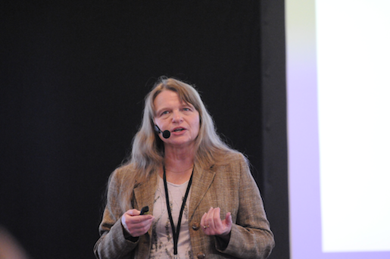
How it All Started
Seminar at NCAR in Feb 2012
2 weeks in Summer 2012
Became UCAR Affiliate in March 2013
2 months in Summer 2013
? Months in Summer 2014
Sue Ellen Haupt
Director, Weather Systems and Assessment Program

Slide 4
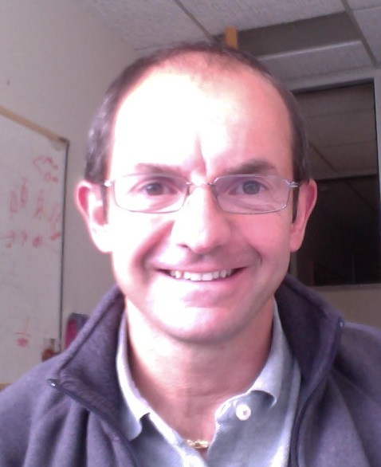
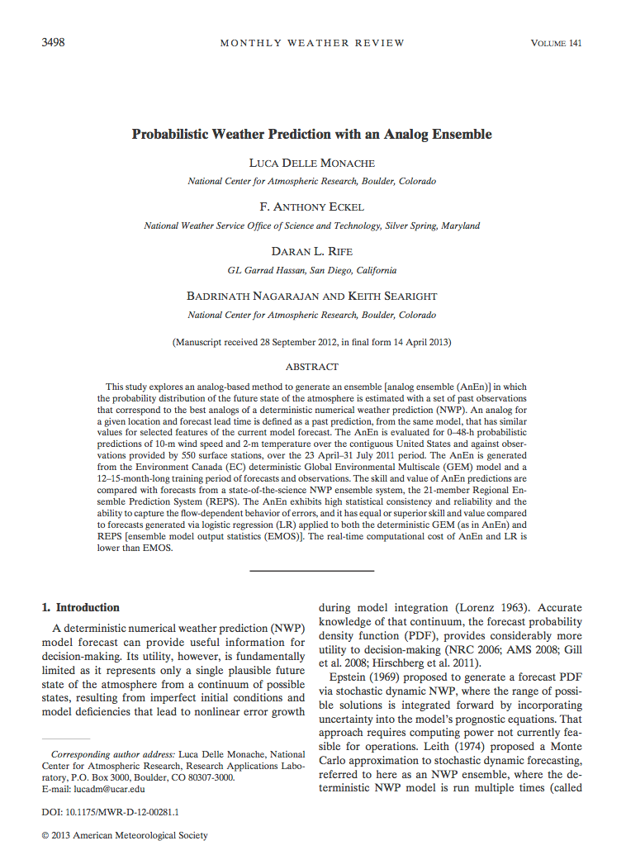
Analog Ensemble (AnEn)
Luca Delle Monache
Project Scientist III, National Security Applications Program

Slide 5
How I got Involved
A: Working on Source Detection
B: I find out about AnEn
C: I decide to work on AnEn

Slide 6
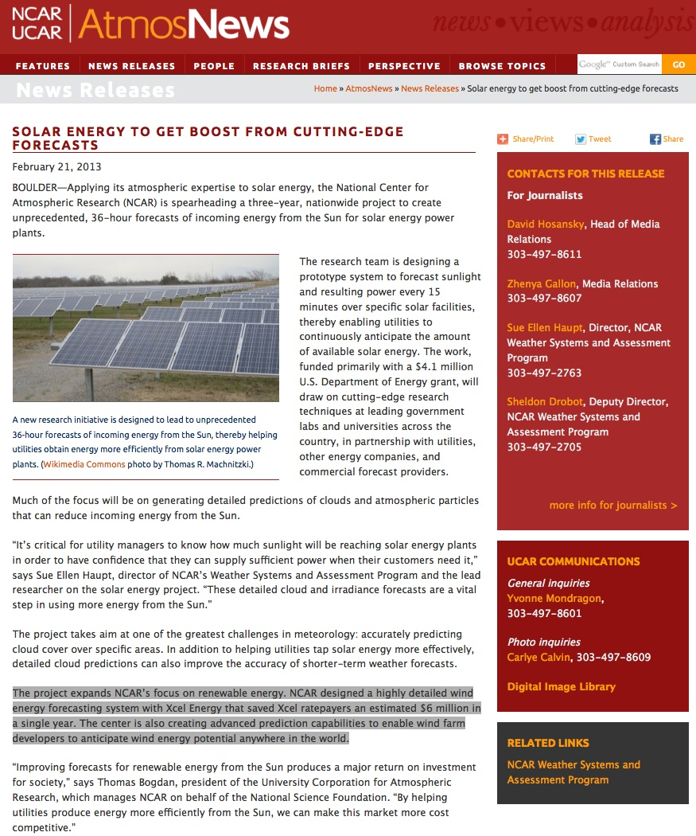
Solar Project
Major Research Project at NCAR
DoE and Xcel
I implemented the AnEn C++ code for the project

Slide 7
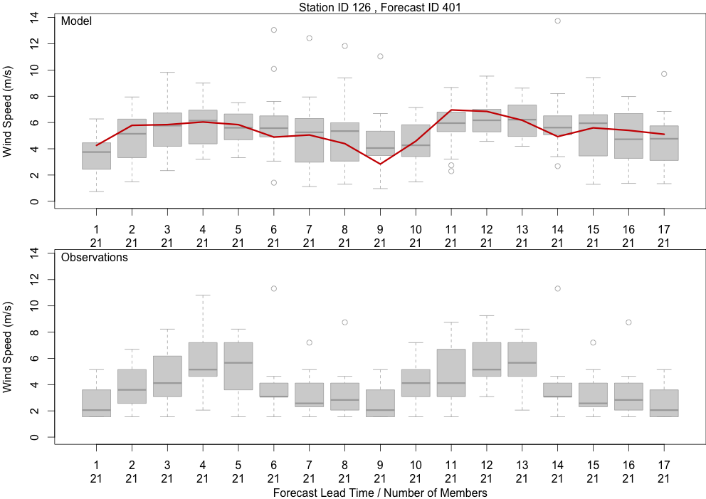
AnEn at Work

Slide 8
AnEn Internals
Parameterized Metric
Predictors Weights
Number of ensemble members
Spatial component
Special cases
Missing observation values
Missing forecast values
Variance not defined
Conditional values

Slide 9
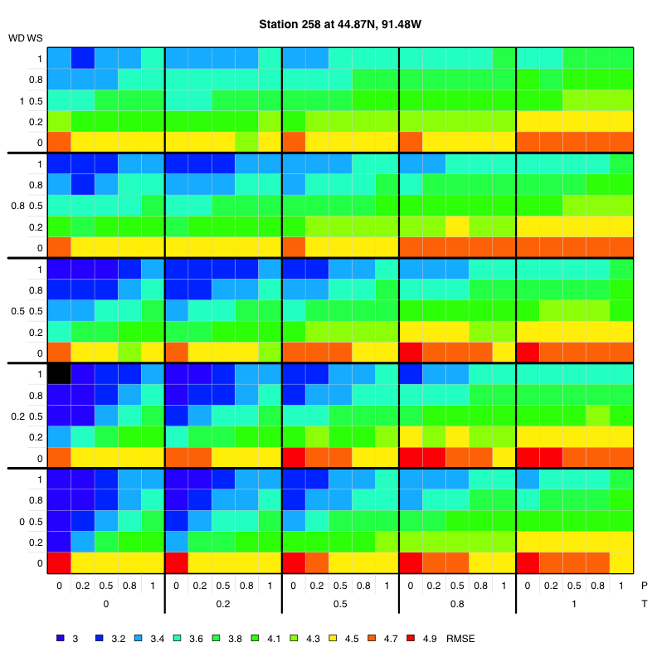
Metric Weights

Slide 10
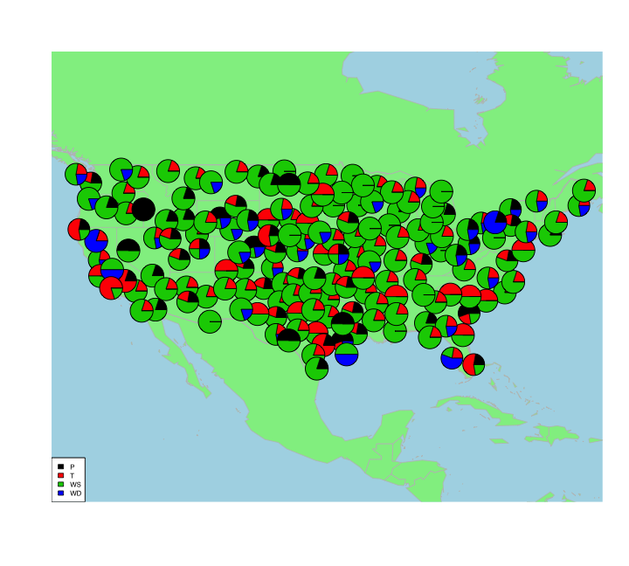
Metric Weights

Slide 11
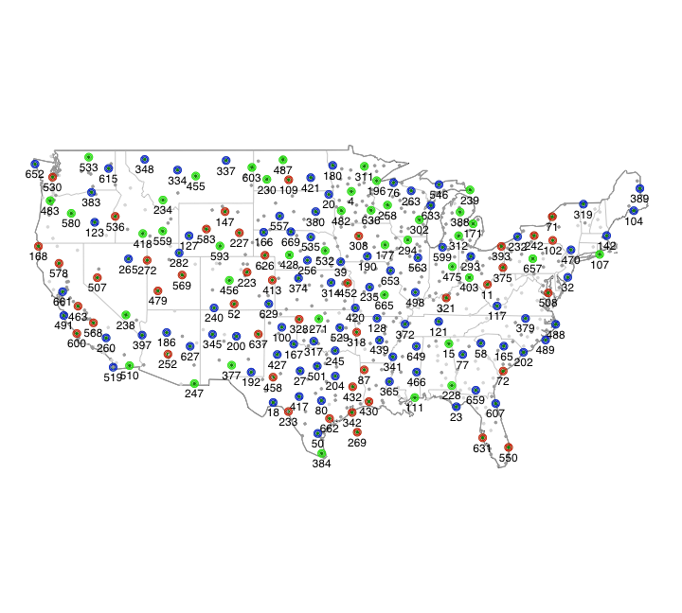
Metric Weights

Slide 12
Location
NCAR
PSU

Slide 13
Location
NCAR
PSU
LDM
GC
AA
TB
SA
EDM
MB
BR
GW
MC
AP

Slide 14

What Language?
print(“Hello World, I speak R!”)
System.out.println("Hello World, I speak JAVA!");

Slide 15
AnEn Implementations
R GC
C++ GC
JAVA GC
R-JAVA GC
R SA
Matlab LDM
Time

Slide 16
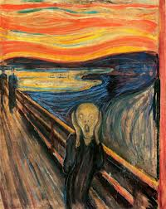
How To Cope?

Slide 17
Additional Challenges
Distributed team
Evolving team
Commitment
Different skills
Pedagogical component

Slide 18
CRAPL
Why the CRAPL?
In academic software (my own included), software engineering principles vaporize as deadlines loom, and code becomes overrun with debugging hooks, perl golf, hard-coded configuration variables, dirty hacks, commentless tracts, a Gordian build system, and of course, no documentation.
http://matt.might.net/articles/crapl/

Slide 19
Implementations
“In the middle of difficulty lies opportunity.”

Slide 20
Agile Development
Agile software development is a group of software development methods based on iterative and incremental development, where requirements and solutions evolve through collaboration between self-organizing, cross-functional teams.

Slide 21
Different Languages
By maintaining different versions / languages
Very hard to synchronize
Replicating all capabilities
BUT
Multiple error checking
Cases not clearly defined (e.g. no variance)

Slide 22
Tools
RStudio
NetBeans
CVS (Here at NCAR)
Problems → gate.ucar.edu

Slide 23
Lesson Learned
It was inefficient but
It worked
Effective debugging
It was fun

